Slide 1

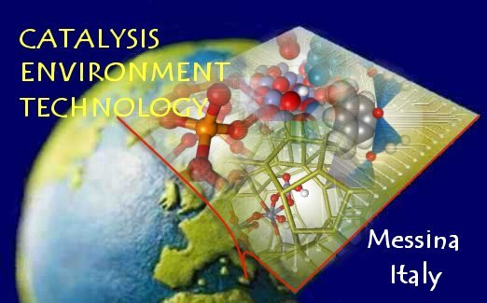

II. Emerging resources and technologies

Slide 2


Challenges and perspectives in producing solar fuels from CO₂ and H₂O
II. Emerging resources and technologies
G. Centi and S. Perathoner
Dip di Ing. Elettr.onica, Chimica ed Ing Industriale, Univ. Messina, ERIC aisbl and CASPE (INSTM Lab of Catalysis for Sustainable Prod and Energy) e:mail: centi@unime.it
Univ. Messina INSTM

Slide 3
Summary /Concepts presented
Introduction
  Solar fuels and the energy infrastructure (renewable energy - RE)
  Need to store and transport RE (energy vectors)
  Solar fuels from CO₂: impact on GHG and to enable RE
  Solar fuels to move to a sustainable chem. prod. scenario
Short-medium term (5 years)
  multistep production of methanol and other fuels
Medium-long term (15 years)
  develop artificial leaves (move to Economy 3.0)
Conclusions
few glimpses

Slide 4
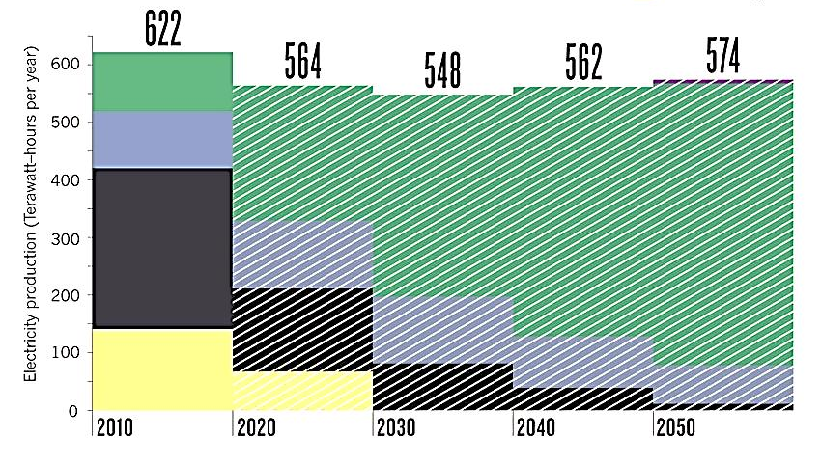
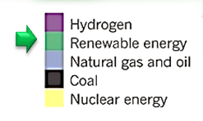
Germany Energy Plant
Pathways to 100% RE
Renewable in 2050 will provide > 85% of electricity
Denmark energy plan: 100% RE in 2050

Slide 5
Technol. issues to increase use of RE
Intermittency
  Storage
    improved systems for energy storage
    devices for chemical energy conversion
Potential unexploited RE sources
  A large part cannot be actually exploited
    not-local uses, too remote for transport
Using RE in process industry
  convert renewable to chemical energy
  produce raw materials for (chemical) industry

Slide 6
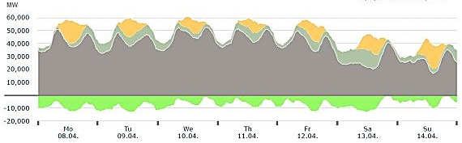
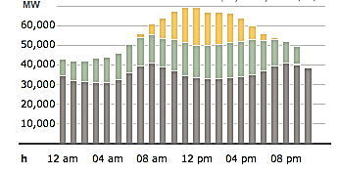
RE (wind, solar) production intermittency
Changes during days
Due to intermittency in RE production,
Already a part of the produced RE cannot be introduced in the grid
(average full load use wind 40%)
Without efficient systems for storage it is not possible to further increase the use of RE
Changes within one day
Smart grids are only a partial solution
(effective on local scale)
Wind energy report Germany 2011 FRAUNHOFER INST IWES

Slide 7
Technol. issues to increase use of RE
Intermittency
  Storage
    improved systems for energy storage
    devices for chemical energy conversion
Potential unexploited RE sources
  A large part cannot be actually exploited
    not-local uses, too remote for transport
Using RE in process industry
  convert renewable to chemical energy
  produce raw materials for (chemical) industry

Slide 8
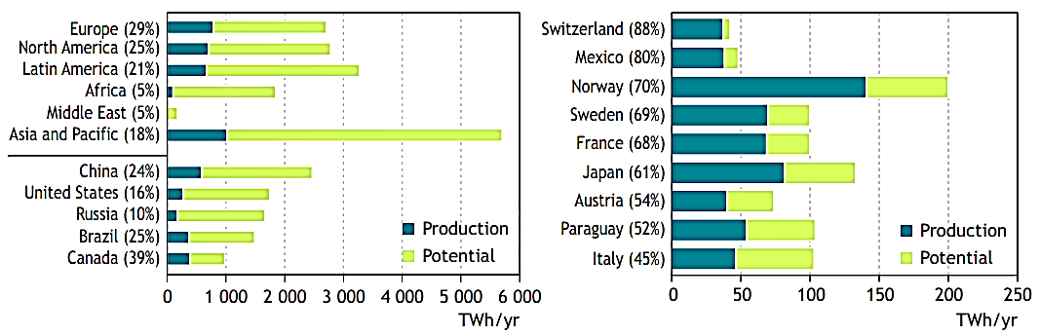
Hydropower potential
Hydropower development ratio for world regions and top five countries with
the highest potential
Countries with largest developed proportion of their hydro potential (countries with hydropower prod. > 30 TWh/yr)
Much larger potential of hydropower, but to fully enable these possibilities it is necessary to transport energy at long distance
Data source: WEC Survey of Energy Resources 2007, IEA Renewables Information 2010

Slide 9
Technol. issues to increase use of RE
Intermittency
  Storage
    improved systems for energy storage
    devices for chemical energy conversion
Potential unexploited RE sources
  A large part cannot be actually exploited
    not-local uses, too remote for transport
Using RE in process industry
  convert renewable to chemical energy
  produce raw materials for (chemical) industry

Slide 10
Introduce RE in chemical prod./process ind.
  a critical element to decrease the carbon and
  environmental footprint
  renewable energy ⇨ produce electrical energy as output (except biomass) in a discontinuous way
    problem to couple with Chem Prod./process Ind.
  Electrical energy does not well integrate into chemical production, except as utility.
    chemical processes: based on the use of heat as the source of energy for the chemical reaction, apart few processes
    In the chemical sector, on the average only 20% of the input energy is used as electrical energy (including that generated on-site) to power the various process units and for other services.

Slide 11
Technol. issues to increase use of RE
Intermittency
  Storage
    improved systems for energy storage
    devices for chemical energy conversion
Potential unexploited RE sources
  A large part cannot be actually exploited
    not-local uses, too remote for transport
Using RE in process industry
  convert renewable to chemical energy
  produce raw materials for (chemical) industry
Use of CO₂

Slide 12
Solar fuels
Concept of solar fuels
  energetic molecules obtained from the use of renewable energy sources and which avoid the use of fossil fuels for energy applications.
  Simpler solar fuel is H₂ (⇨renewable H₂)
  BUT the actual trend is to produce liquid fuels
    can be easier stored and transported to long distance.
Role of CO₂
  the fuels which can be produced from CO₂ and ren.H₂ (methanol, DME, hydrocarbons, etc.) are the preferable energy vectors which integrate well into the actual energy infrastructure (eg. low investments for transition)
G. Centi, S. Perathoner, Greenhouse Gases: Science and Techn. 2011, 1, 21–35.
G. Centi, S. Perathoner, ChemSusChem 2010, 3, 195-208.

Slide 13
New scenario for sustainable chem. prod.
New raw materials and green energy for chemical production value chain
G. Centi, S. Perathoner, ChemSusChem 2013 (subm.)
CO₂ and (waste) biomass are the raw materials resources of Europe

Slide 14


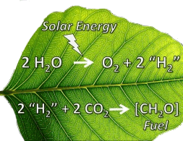
CO₂ utilization
Realize energy efficiency
  A resource & energy efficiency chemical production
    reduce use fossil fuels as raw material AND energy vectors
    introduce renewable energy in the chemical production chain
  Import unexploited renewable energy (RE) resources
    via renewable H₂ (water electrolysis) using remote RE sources
    and CO₂ conv. to methanol or other CO₂-derived energy vectors
    produce solar fuels and chemicals
  Local storage on RE in smart grids
    Power-to-gas (CO₂ to CH₄)
  Develop artificial leaves
    in a long-term, for distributed production

Slide 15

CO₂/RE: relevant and cost-effective route
further benefits
reduced emissions of both pollutants (NOx, etc.) and greenhouse gases
  use of unexploited renewable energy sources reduces the need of new power plants as well as of extraction of fossil fuels
better diversification of energy resources and greater flexibility in use
  with benefits in terms of energy security; methanol or DME can be used to produce components for the transport sector, for example
better flexibility in energy management to follow fluctuating energy demand,
  methanol-fuelled turbine have a rapid switch off-on time; methanol is considered a superior turbine fuel (even if the system must be modified), with low emissions, excellent heat rate, and high power output.

Slide 16
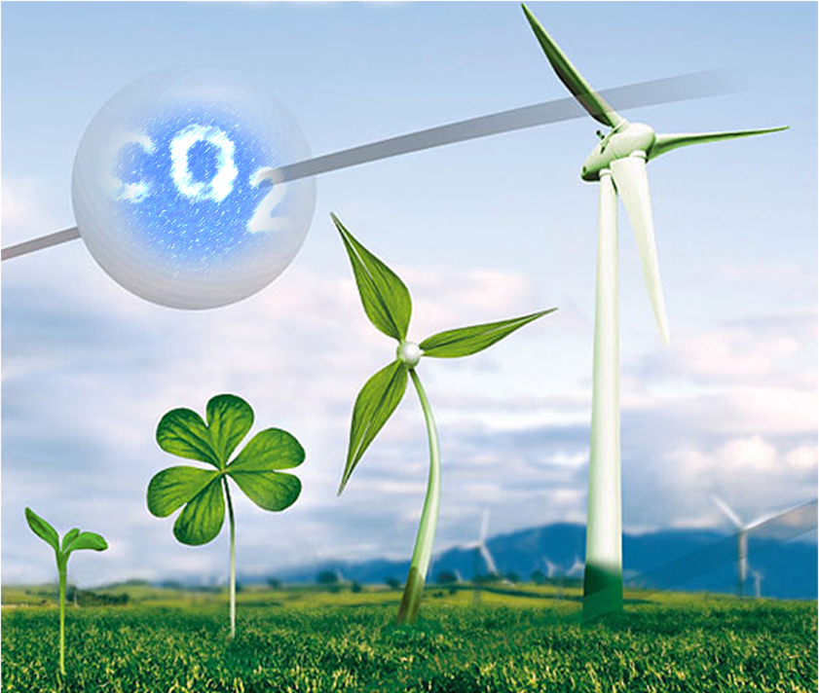
Paths to link CO₂ and RE for chem./energy industry
CO₂ as a valuable carbon source
  CO₂ to olefins
CO₂ as energy vector for remote (or underused) electrical energy sources
  CO₂ to methanol
    techno-economic estimations
  Formic acid to transport H₂
  Power-to-gas
Solar fuels from CO₂ and H₂O
  Going to artificial leaves

Slide 17



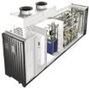



CO₂ re-use scenario: produce CH₃OH
using cheap ee in remote areas
An alternative (and more effective for chem. ind.) way to CCS
CH₃OH
CO₂ cargos for Carbotube 75
Improved electrocatalysts (reduce overpotential)
CO₂
H₂
New catalysts for CO₂ to methanol (role H₂O)
Catalysts to be used in microreactors
CH₃OH
H₂
An efficient (and economic) way to introduce renewable energy in the chemical production chain
CH₃OH
17

Slide 18
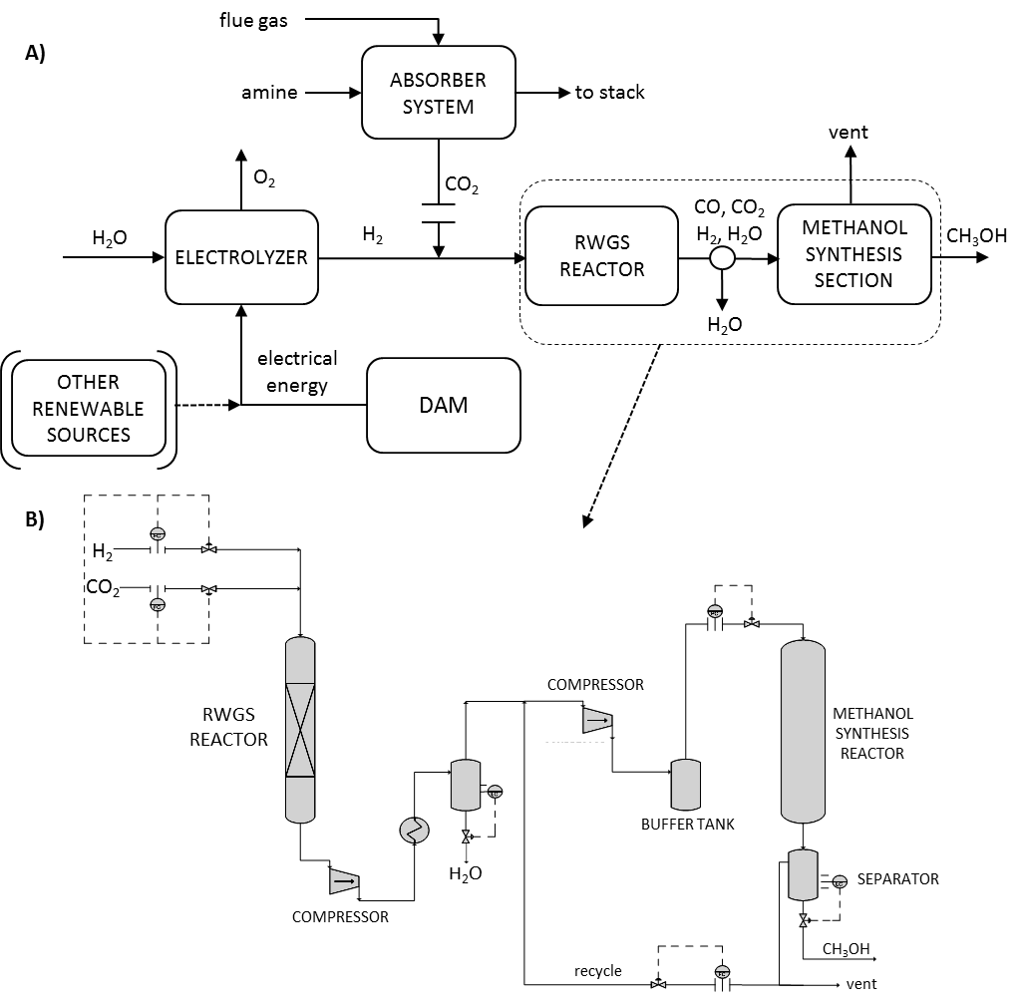
Simplified block diagram of different material flows participating into the process of methanol synthesis from CO₂ and renewable H₂.
two stages methanol synthesis from CO₂

Slide 19
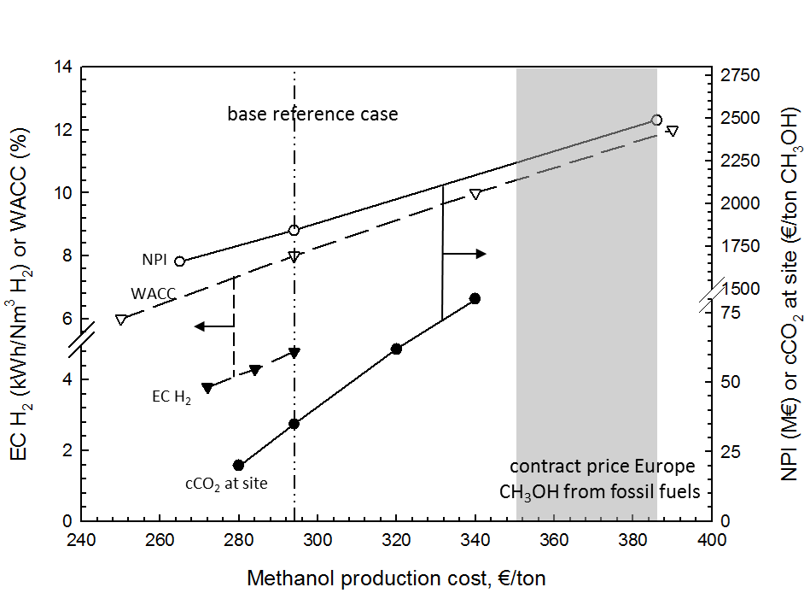
Cost of CH₃OH from CO₂ (remote ee/ren. H₂)
WACC: Weighted Average Cost of Capital
cCO₂ at site: cost of CO₂ at site (related to recovery),
NPI: new plant investment cost
EC H2: electricity consumption for the H₂ production
Sensitivity analysis of the methanol production cost from CO₂ and renewable H₂ as a function of four main parameters. The cost estimated for the base reference case and the actual range (Aug. 2013) for contract price of methanol in Europe are also indicated.

Slide 20
CO₂ current vs. potential future chem. use
potential saving CO₂ eq.(world scale) (use 10PWh unexploited RE)
potential (world scale) (~15% olefin world prod.)
0,2 Mtons CO₂ ⇨ ~ 0,8 Mtons chemicals
potential future uses
2 Mtons CO₂ ⇨ ~ 5 Mtons polymers
current physical use, can be increased by EOR
current uses
CO₂ co-feed with syngas
but a VIRTUAL CO₂ that derives from NH₃ (H₂) synthesis

Slide 21
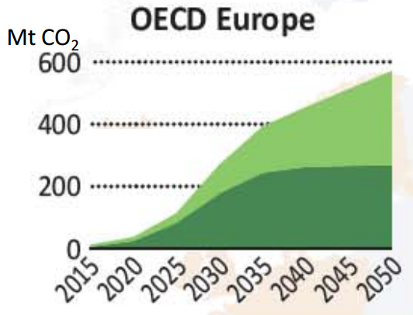



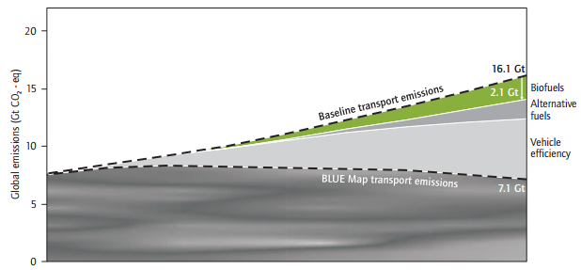


Comparison of the CO₂/RE path with CCS and biofuels
estimation for Europe, by 2050
CCS ~ 600 Mt CO₂
  effective contribution nearly half
  ⇨ energy need for CO₂ capture,
  transport and storage
biofuels ~ 700 Mt CO₂
  lower if considering land
  change use & other aspects
CO₂/RE: potential impact > 800 Mt CO₂
  15% of unexploited RE, includes about 0.2 tons CO₂ per ton CO₂ eq.
  of energy for the conv. to methanol; the impact is related to avoided CO₂
  by introducing RE in the energy chain
IEA: Energy Technology Perspective 2012
(2.1 Gt CO₂-eq. by 2050 on global scale)
BLUE Map targets
CO₂/RE is an effective solution to contribute to mitigate on climate change

Slide 22
Comparison of the CO₂/RE path with CCS and biofuels
estimated costs (Europe)
CCS
  average 60€/ton captured
  tot. cost in year 2050 per 1Gt CO₂ removed EU ⇨ 60 B€
biofuels
  IEA (BLUE Map Scenario): "... Between 2030 and 2050, total incremental costs for biofuels are around US$ 330 billion in the high-cost scenario..." (oil at US$ 120/bbl in 2050)
  tot. cost in year 2050 per 1Gt CO₂ removed ⇨ 35 B€
CO₂/RE
  considering 20€/ton subsidies to make methanol cost eq. to fuel projected cost
  tot. cost in year 2050 per 1Gt CO₂ removed ⇨ 20 B€
CO₂/RE is the cost-effective solution for GHG emission reduction

Slide 23

A CO₂ roadmap
2012 2020 2030
excess electrical
energy (discont.,
remote,...)
PEC
H₂ prod.
(Conc. solar,
bioH₂,...)
artificial
leaves
ee
ee
electrolyzers
(PEM)
inverse
(methanol)
FC
H₂
H₂
catalysis
G. Centi, S. Perathoner et al., ChemSusChem, 2012
catalysis
CH₃OH, DME, olefins, etc.
CH₃OH, DME, olefins, etc.
CH₃OH, DME, olefins, etc.
distributed energy
in chemical industry to increase use
of renewable energy

Slide 24
New routes for producing renewable H₂
bio-route using cyanobacteria or green algae
high temperature thermochemical one using concentrated solar energy
photo(electro)chemical water splitting or photoelectrolysis using semiconductors
The low temperature approach (PEC solar cell) has a greater potential productivity in solar fuels per unit of area illuminated AND may be used also for C-based energy vector
productivities in H₂ formation from water splitting per unit of surface area irradiated
Centi,, Perathoner, ChemSusChem, 3 (2010) 195.

Slide 25
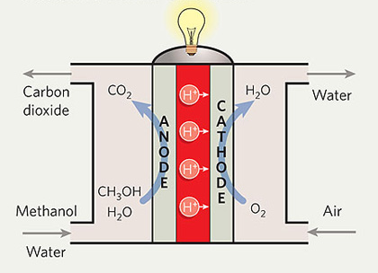
Integrating the stages in CO₂ conversion
inverse (methanol) fuel cells
ee
Formally analogous, BUT new type of electrocatalysts are requires
(cell and electrode engineering remains similar)

Slide 26
Towards artificial leaves
Helios SERC
CalTech (Lewis research group).
Still mainly at the conceptual design

Slide 27
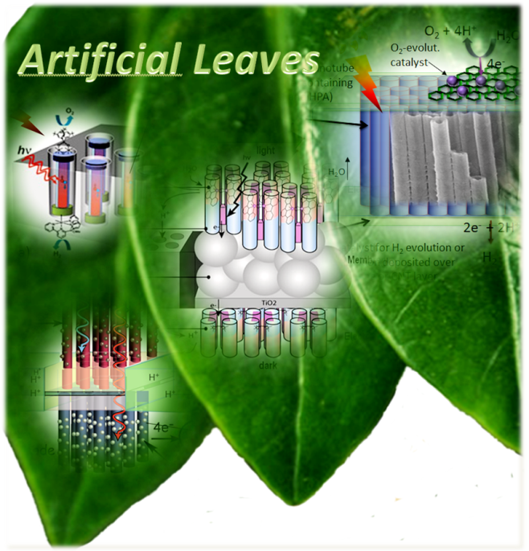
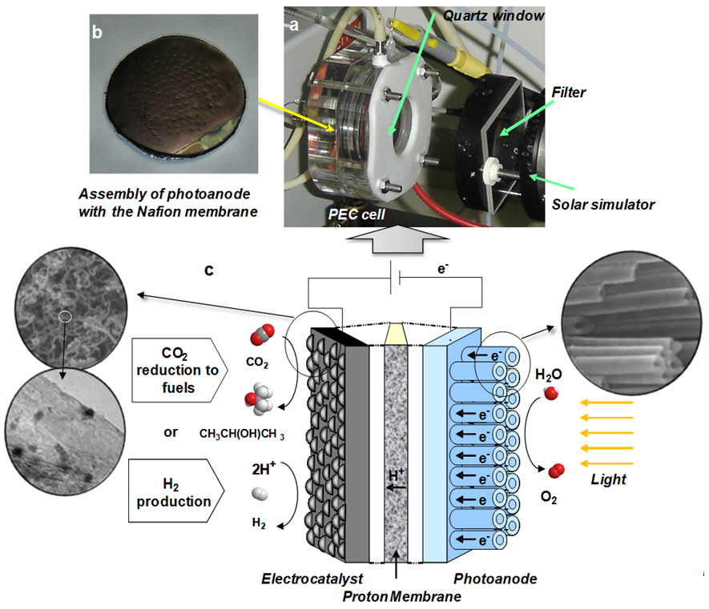
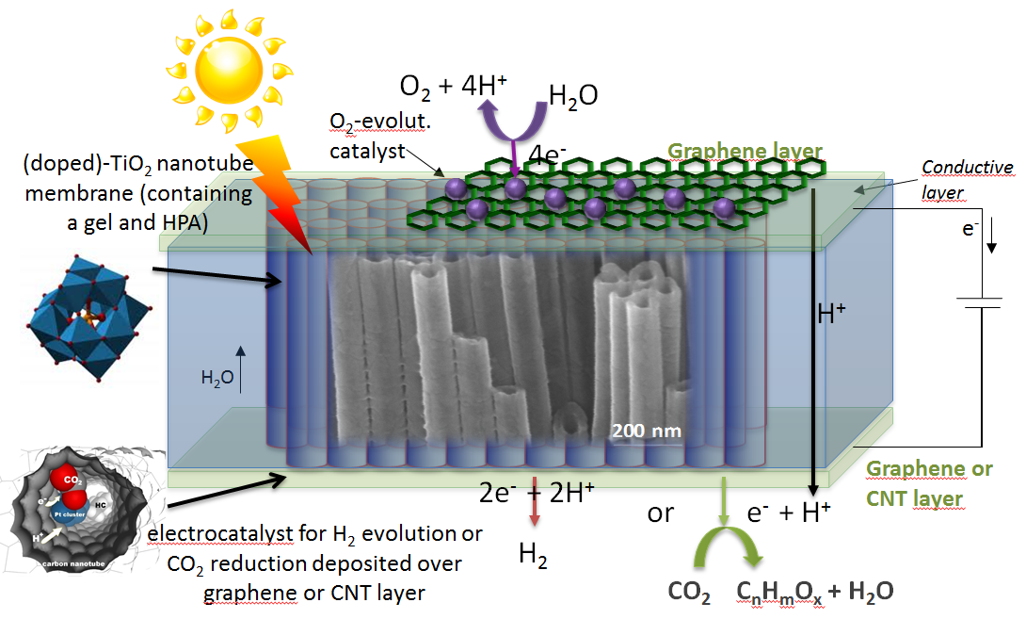
Toward artificial leaves
1st generation cell
2nd generation cell
G. Centi, S. Perathoner et al., ChemSusChem, 2012

Slide 28


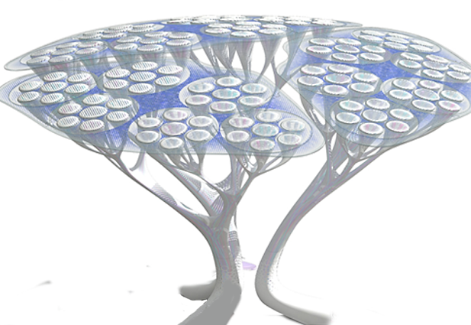
Vision 2050: CO₂/artificial leaves
Provide a delocalized energy
  to smart cities and buildings
  for mobility and industry
O
C
artificial leaf
O
Light reaction
2H₂O ⇨ O₂ + "2H₂"
Dark reaction
"2H₂" + CO₂ ⇨ (CH₂O)
O
C
O
(liquid HC, alcohols)

Slide 29


CO₂/Artificial Leaves
EU challenge

Slide 30



Conclusions
(re)using CO₂ to produce solar fuels can be a disrupting (game changer) opportunity for Europe and to meet societal challenges
  large potential (Gtons CO₂ eq.) to exploit unused renewable energy resources, contributing to meet GHG targets, decreasing impact on environment and improving energy security
  open new scenario for sustainable chemical production and energy, with increase in competiveness, innovation and jobs
base economic elements indicate feasibility
  the development of related technologies/catalysts/materials will be a main driver for innovation ⇨ combine efforts in Europe to win this race
in a long term the vision is to develop artificial photosynthesis (artif. leaves)
  bio-inspired, with higher productivity and tailored conversion of CO₂
  Economy 3.0 (direct, delocalized energy production)
ISBN: 978-3-11-027729-6
ISBN: 978-1-118-59088-1
ISBN: 978-1-4471-5118-0

